Slide 1


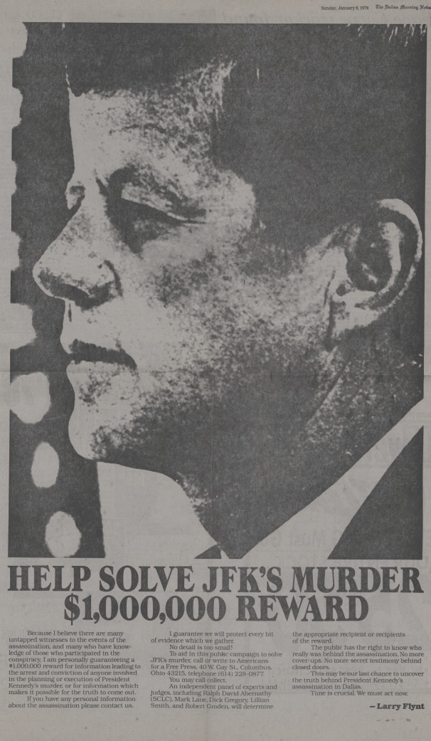

Evaluating Evidence in the case against
Lee Harvey Oswald
Click the pictures throughout the slideshow to view and zoom in on the originals.

Slide 2
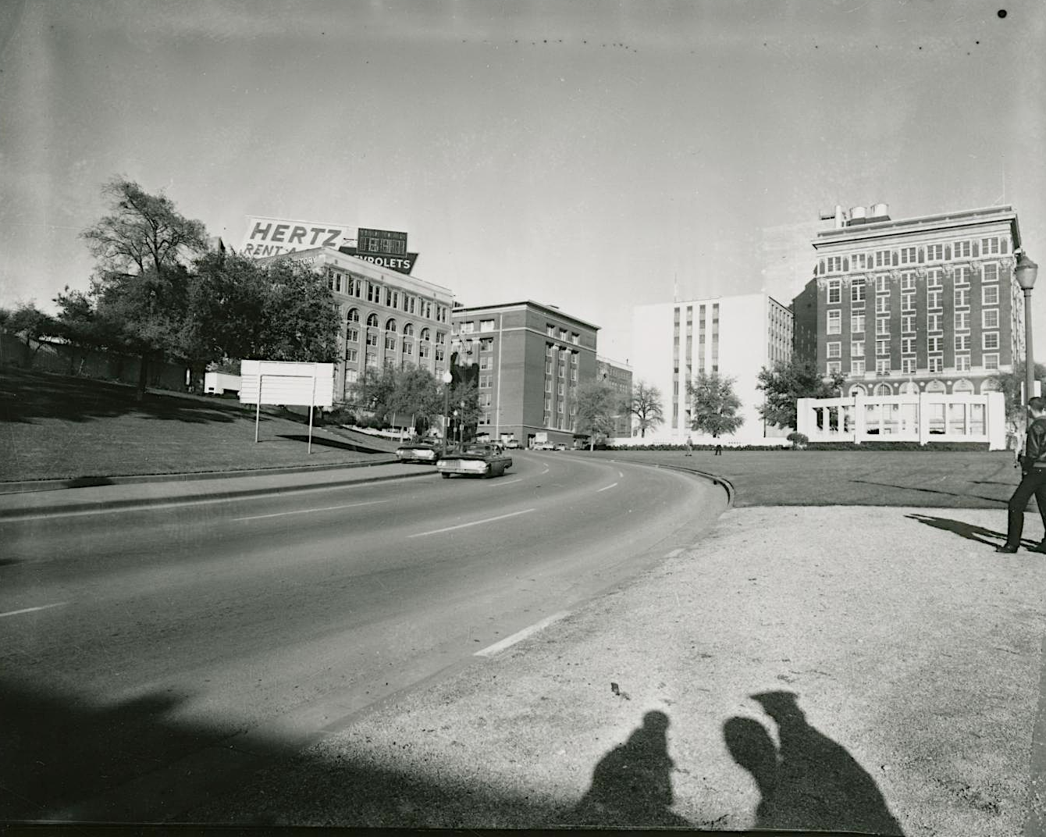
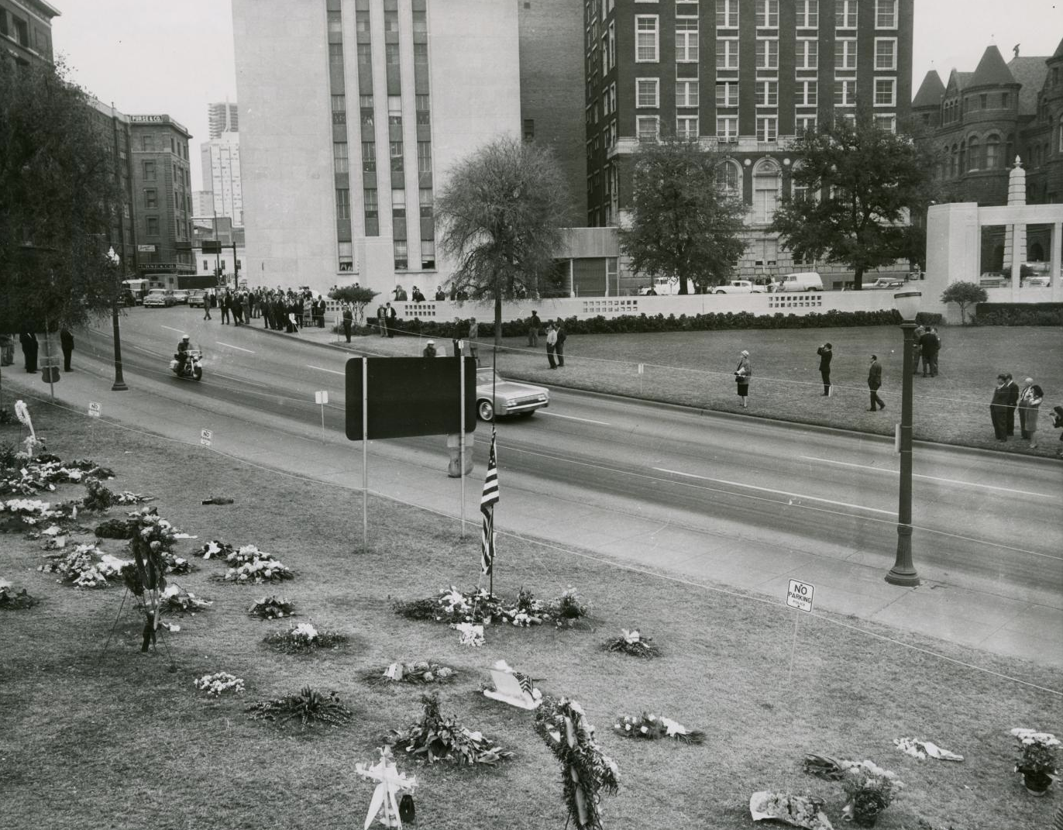
Location #1: Parade Route
The Texas School Book Depository can be seen on the left.
Where the first shot landed on the President.

Slide 3
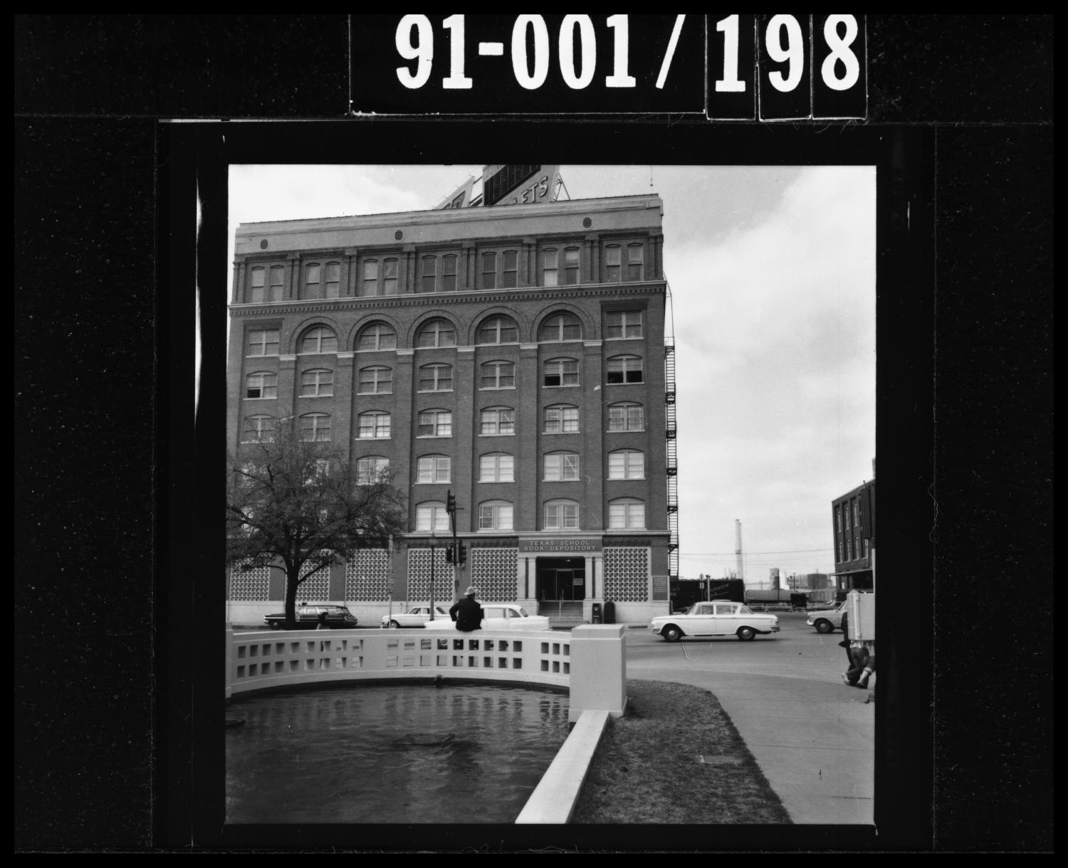
Location #2: Texas School Book Depository, Dallas, TX

Slide 4
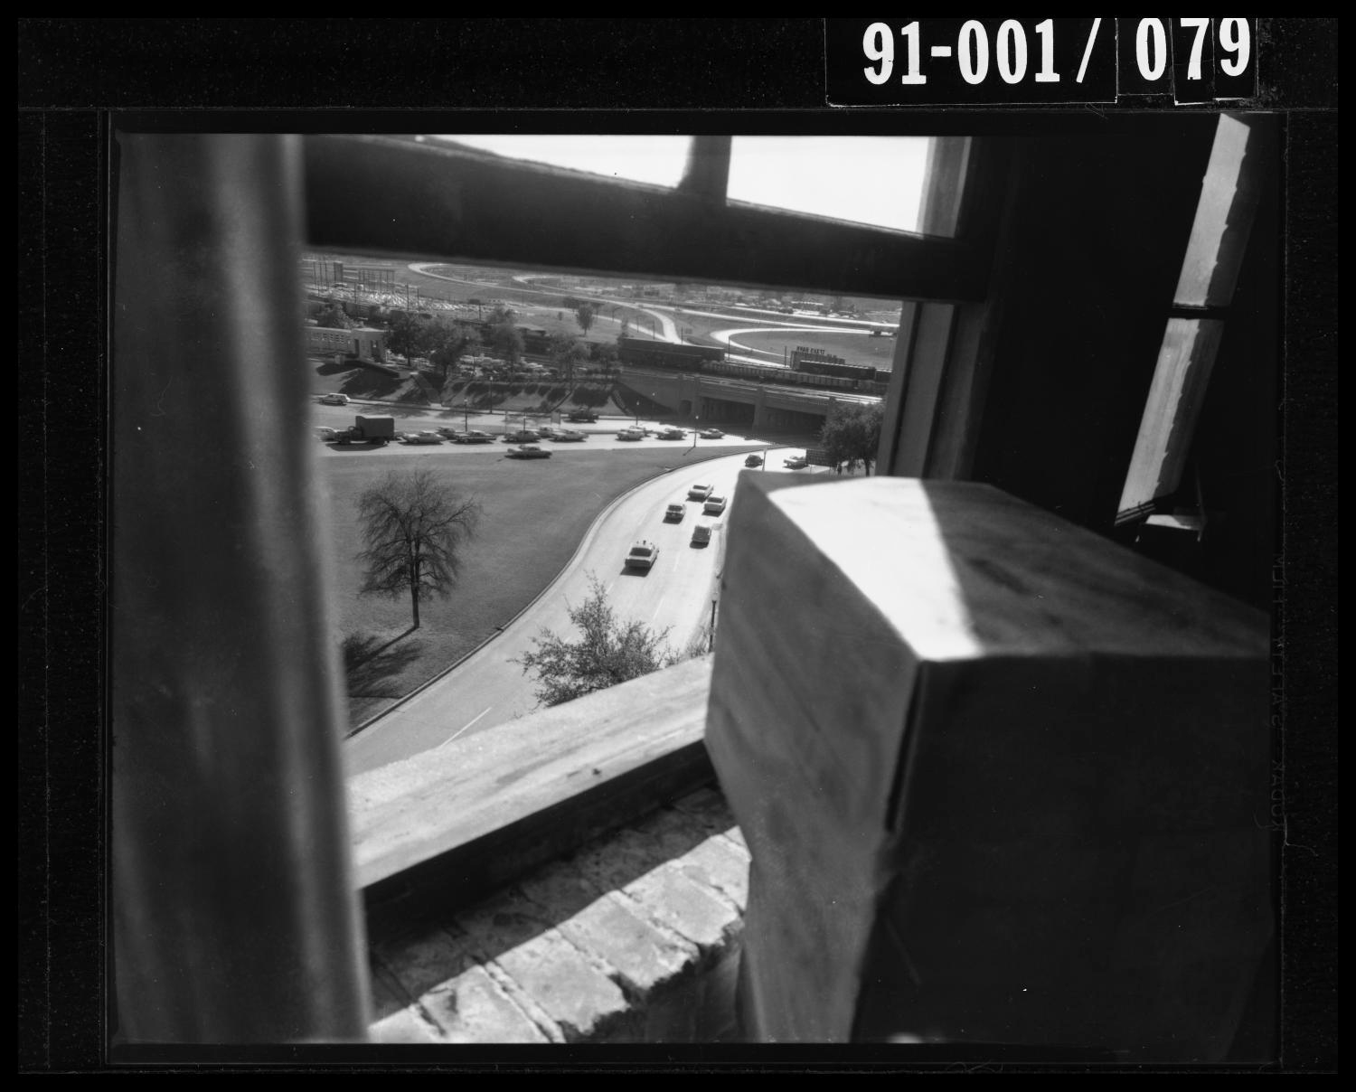
Location #3:
6th floor of Texas School Book Depository,
Sniper’s View
The sniper would have had a clear shot from this vantage point.
The motorcade passed nearly directly under this window.

Slide 5
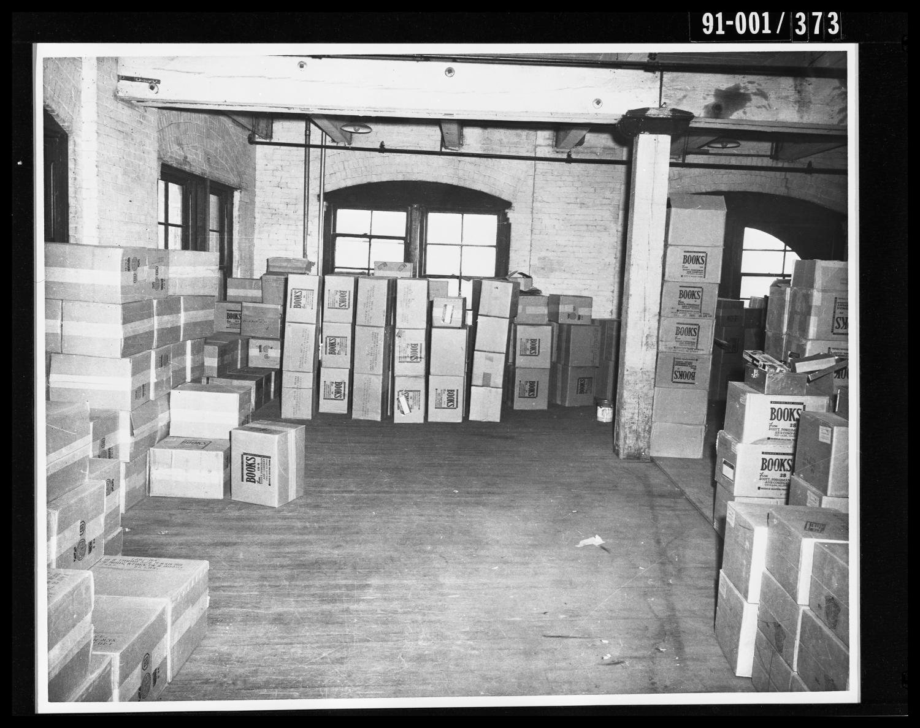
Evidence #1: The Barricade
Boxes were stacked in front of the sniper’s
window so no one could see him.

Slide 6
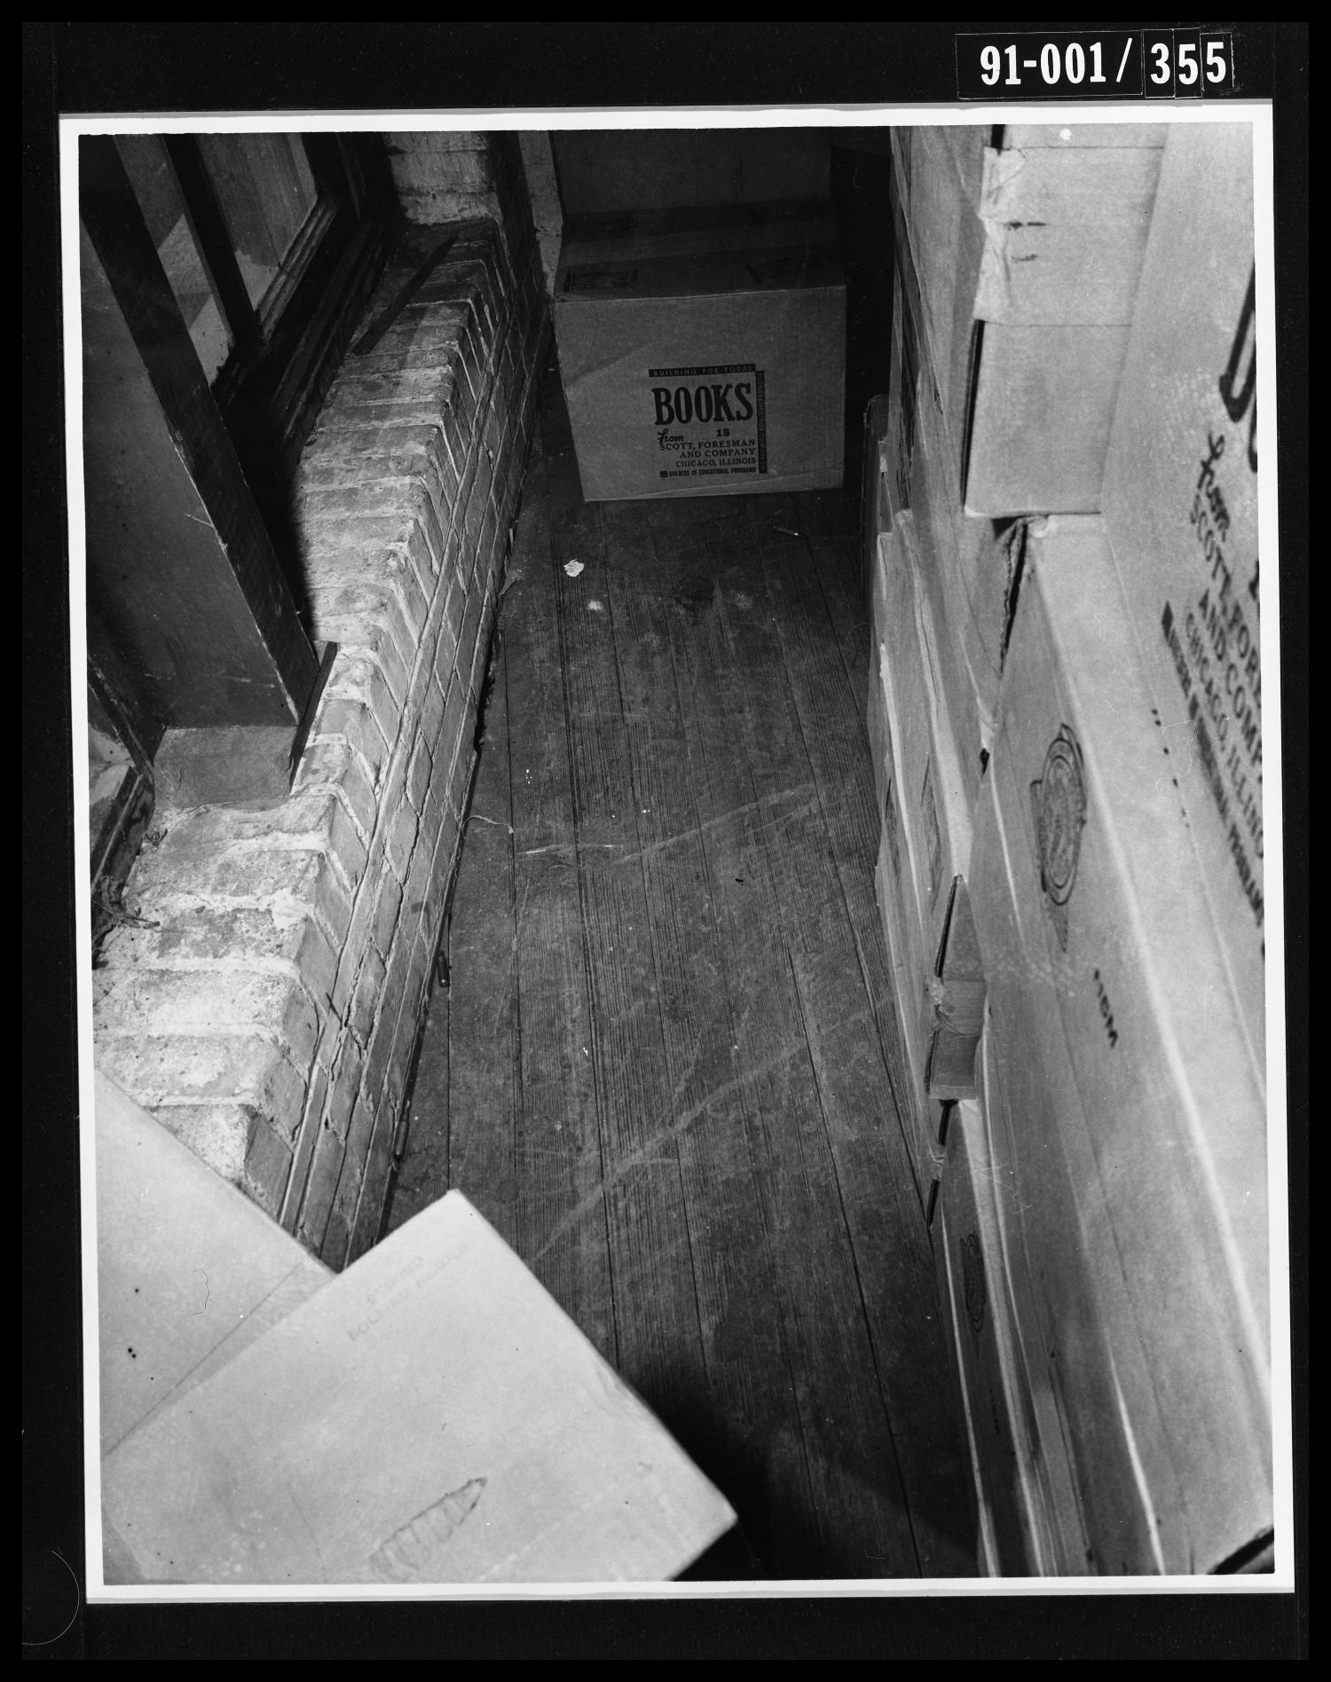
Evidence #2: Spent Shells
Case Report: Found 3 empty 6.5 rifle shells on 6th floor.

Slide 7
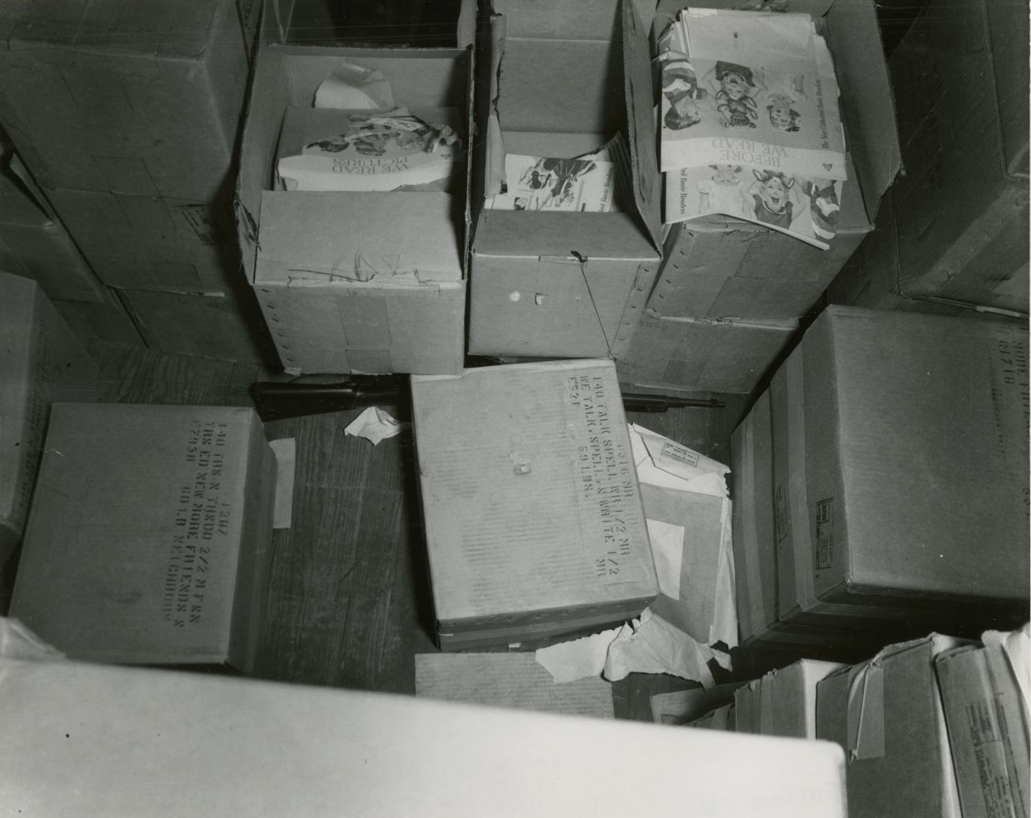
Evidence #3: Rifle
The rifle was found between some boxes and it matches the rifle Oswald was holding outside of his home.
(see next slide)

Slide 8
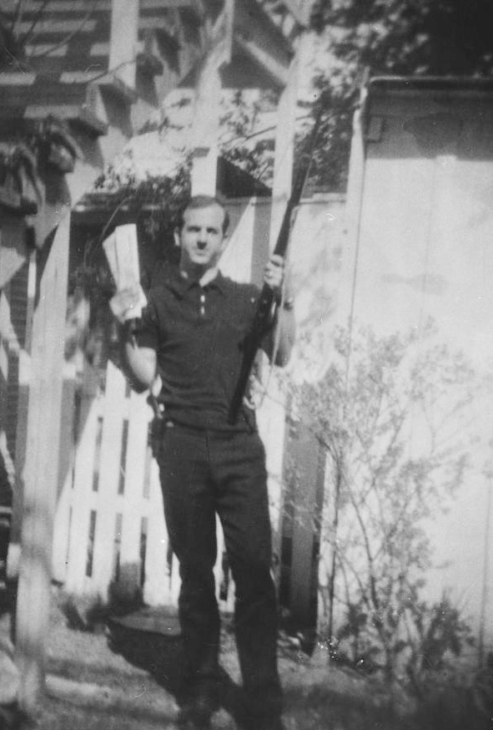
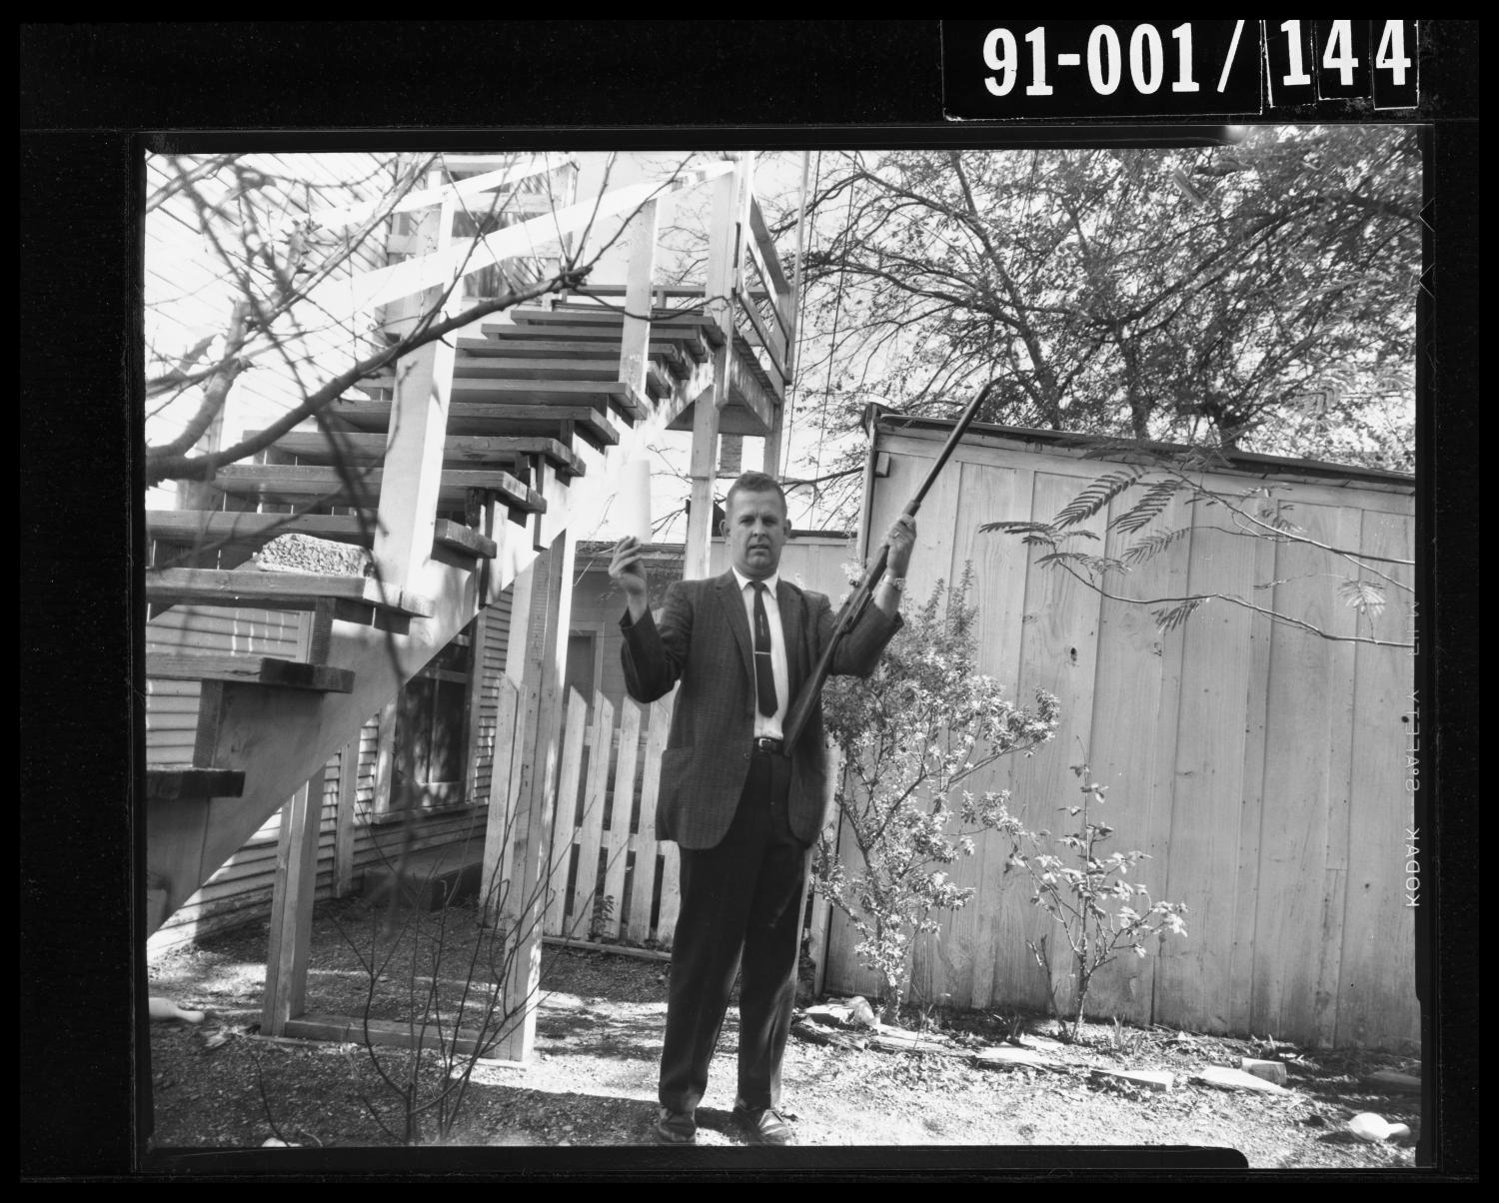
Evidence #3: Rifle (continued)
Officer #1: Made search [of Oswald’s residence]. Found picture of defendant holding a rifle similar to the one defendant used at time of offense.
Officer #2: Was present when defendant’s wife made identification of defendant’s rifle.
A detective posing with the same rifle and papers
Oswald held in his photo.

Slide 9
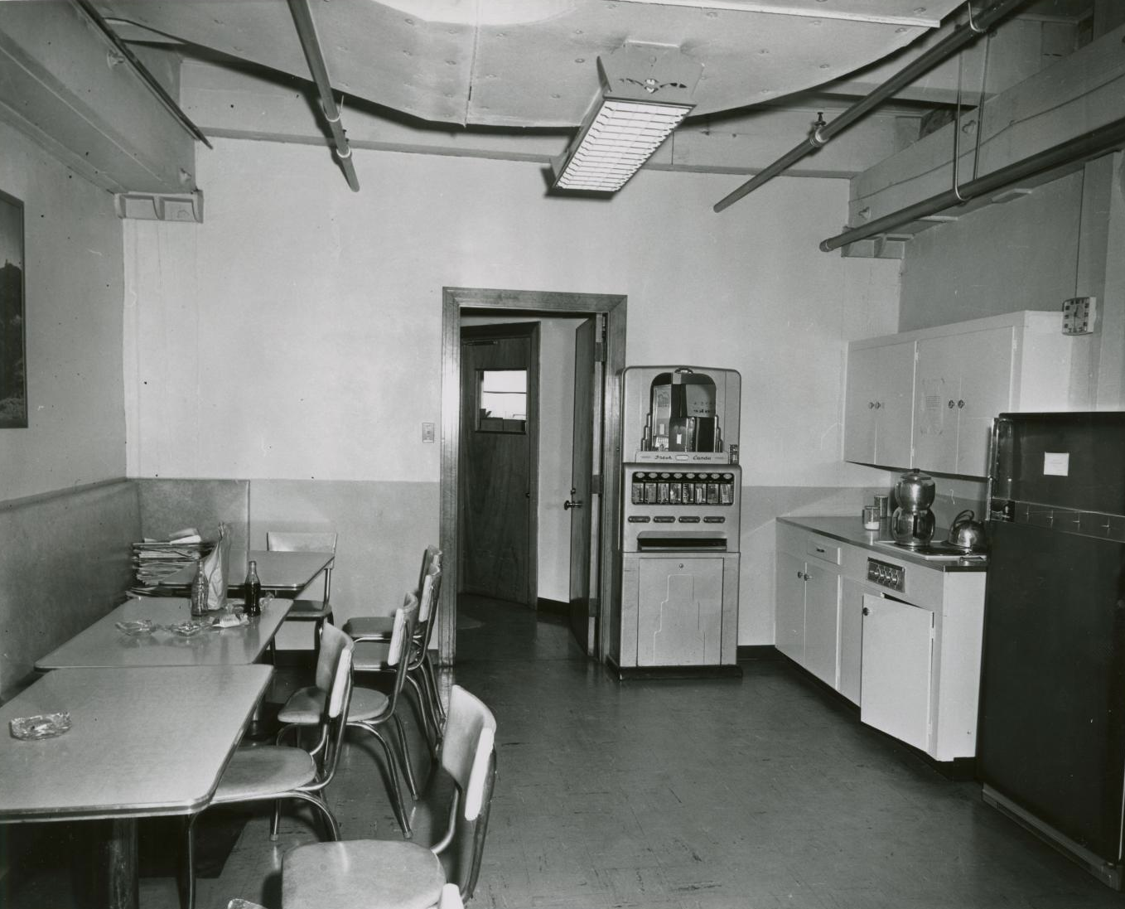
Evidence #4: The Lunchroom
Policemen saw Oswald in this lunchroom when they initially entered the Texas School Book Depository. The supervisor confirmed that Oswald had been working there for several months. Later, when the supervisor did a roll call, he discovered Oswald had fled the scene.

Slide 10
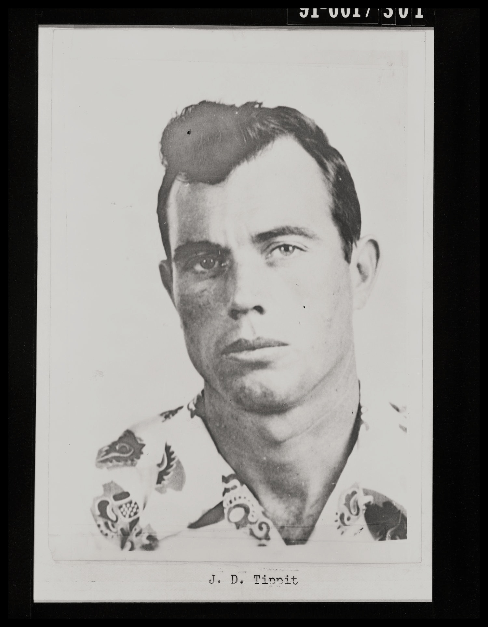
Evidence #5: Officer J.D. Tippit shot
Case Report: Oswald was walking west when stopped by Officer Tippit to be questioned. When Tippit got out of his squad car to walk around in front, Oswald pulled a .38 pistol and shot Officer Tippit three times.
Witness #1: Can testify she heard some shots on the afternoon of the Tippit shooting. She jumped up, looked out the door and saw Oswald running across the yard unloading a pistol. After police arrived, she showed them the spot, and a empty shell was found. She later identified Oswald as #2 man in 4-man line up.
Witness #2: Can testify that she heard the shots that killed Officer Tippit and saw Oswald running from the scene. She later that same day identified Oswald as #2 man in 4-man line up.

Slide 11
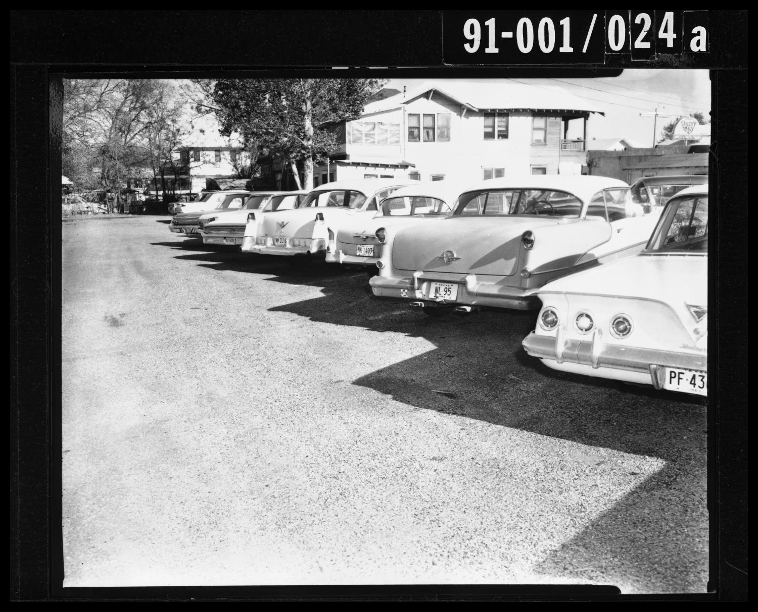
Evidence #6: Oswald’s jacket
Witness: Oswald’s jacket was found between the shooting scene and Texas Theater where arrest was made.

Slide 12
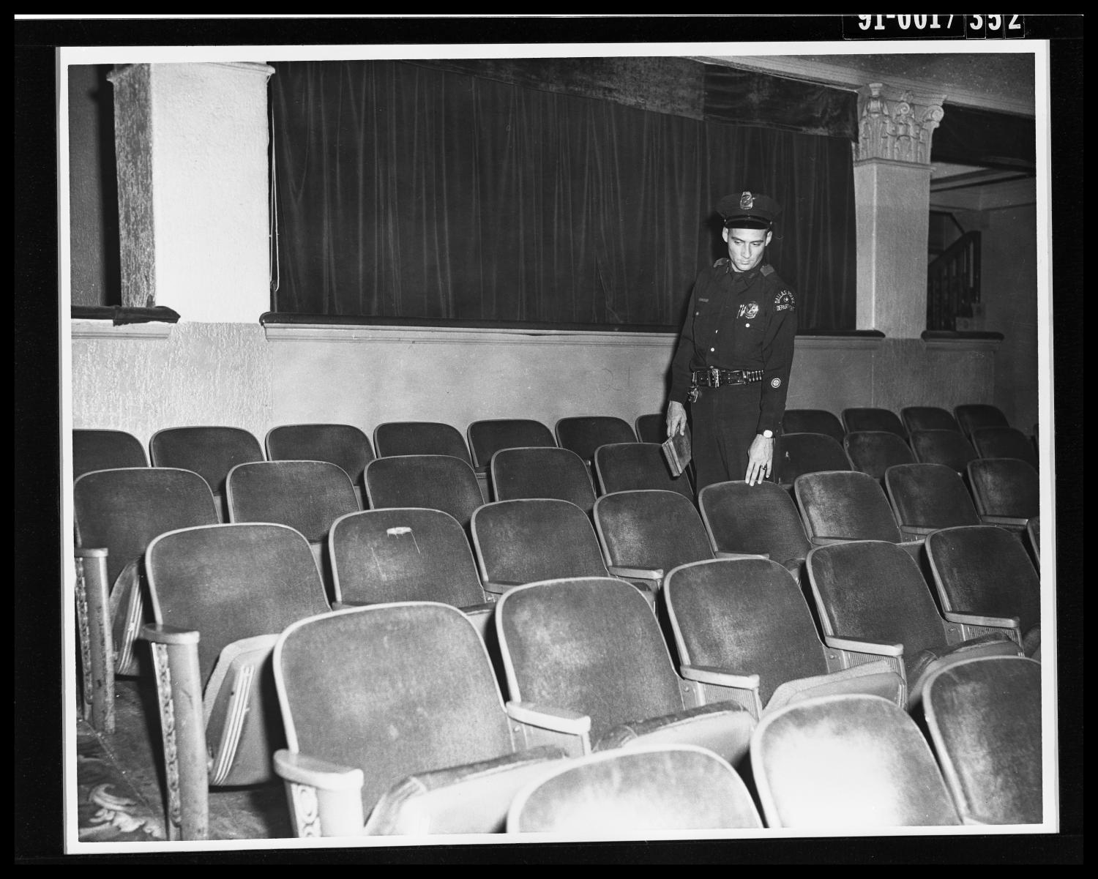
Evidence #7: Oswald had a pistol with him when apprehended in the Texas Theater
Witness: Can testify that she is employed at the Texas Theater. That she saw a suspicious person duck into the theater, just after the shooting. That she called the Police and saw the man later identified as Oswald.
Officer: Can testify that he answered a call to the Texas Theater....they entered the rear door and proceeded to the rear of the theater checking several people as he went. He came to Oswald seated in the center section in rear of theater. When he approached him, he told Oswald to stand up. Oswald did, bringing his hands to shoulder height. He then struck McDonald in the face. He then grabbed Oswald and began struggling with him, hollering for help from other officers. While struggling for possession of Oswald’s pistol it was snapped one time in his face. He did succeed in getting the pistol and giving it to another officer.

Slide 13
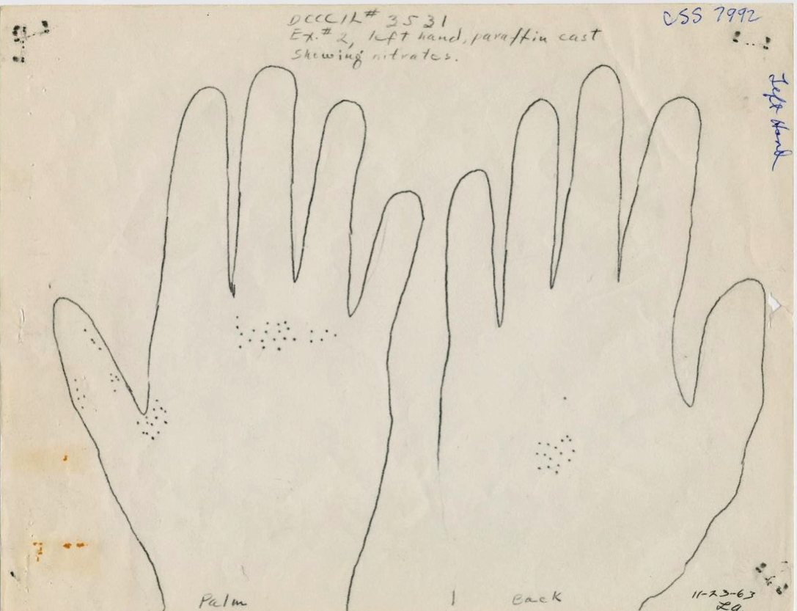
Evidence #8: Nitrate test: positive
Ex.#2: Left hand
Ex.#3: Right hand
Result of Examination:
Nitrate patterns consistent with the subject having discharged a firearm were present on Exhibits #2 and 3.
The pattern on Exhibit #3 is typical of the patterns produced in firing a revolver.

Slide 14
Despite this evidence, conflicting stories from witnesses raise questions:
Claims that Oswald was not in window during the time of the shooting:
http://texashistory.unt.edu/ark:/67531/metapth337256/m1/1/sizes/
Attorney has devoted himself to “pecking holes in the case against Oswald”:
http://texashistory.unt.edu/ark:/67531/metapth339183/
Testimonies suggesting that two men were seen with a gun in the sixth floor window of the Texas School Book Depository:
http://texashistory.unt.edu/ark:/67531/metapth339748/
Questionable film surfaces suggesting two gunmen:
http://texashistory.unt.edu/ark:/67531/metapth339865/
Garrison moves to get more witnesses:
http://texashistory.unt.edu/ark:/67531/metapth338736/
Questionable evidence: (button off of policeman’s uniform)
http://texashistory.unt.edu/ark:/67531/metapth337080/m1/17/

